Slide 1
Global PPC Award Template
Updated Q4 2012

Slide 2





Background/Brief
J&J Paid Search Toolkits
Background
J&J Digital program workshop – indentified limited search activity across markets due to the central and local market brand managers having low search knowledge.
Brief
Increase search knowledge of central client, local market brand managers and the Carat team.
Increase the search activity in each market whilst implementing best practice principles and consistency across each market.
Paid Search

Slide 3

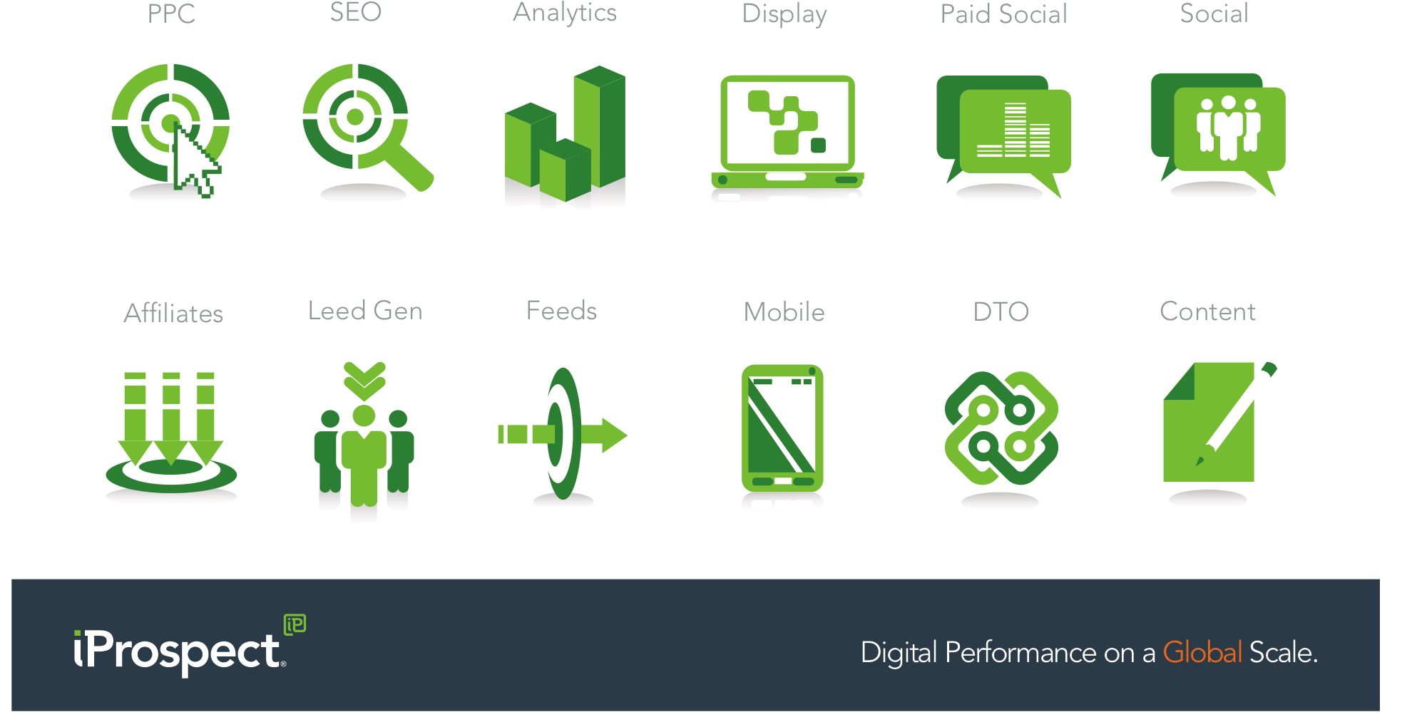
Challenge
Increasing Search Knowledge & Activity
Paid Search???!!
Challenges
Central client and local market brand managers had low search knowledge.
Carat team had low level search knowledge.
The central client could not tell the local brand managers how much budget should be allocated to paid search.
Local brand managers unwilling to spend more in search due to lack of knowledge of search

Slide 4
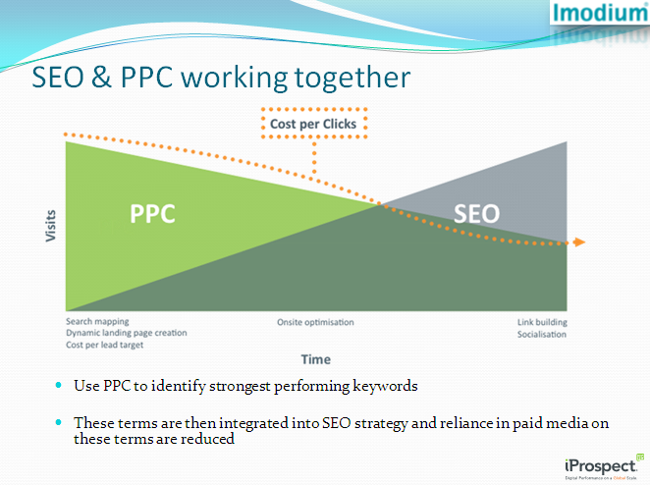
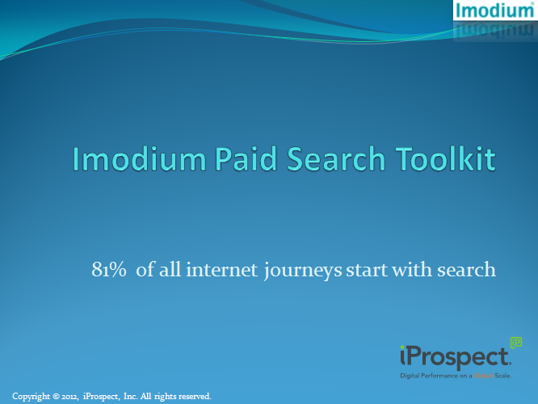
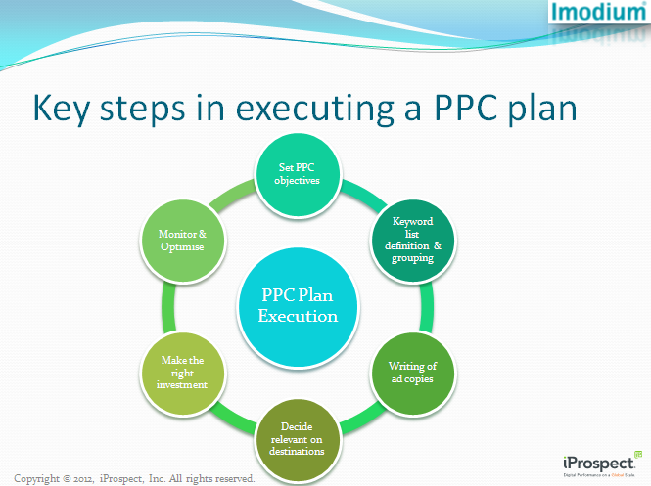
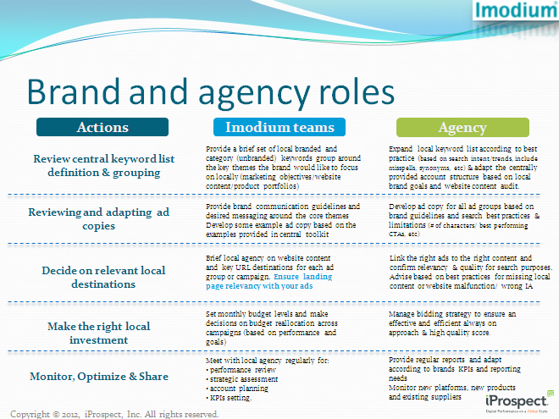
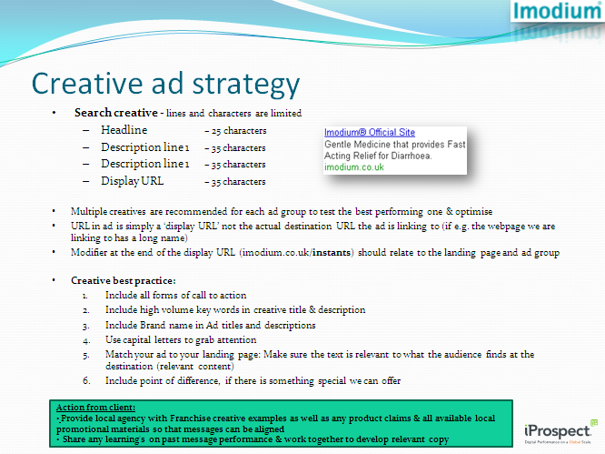
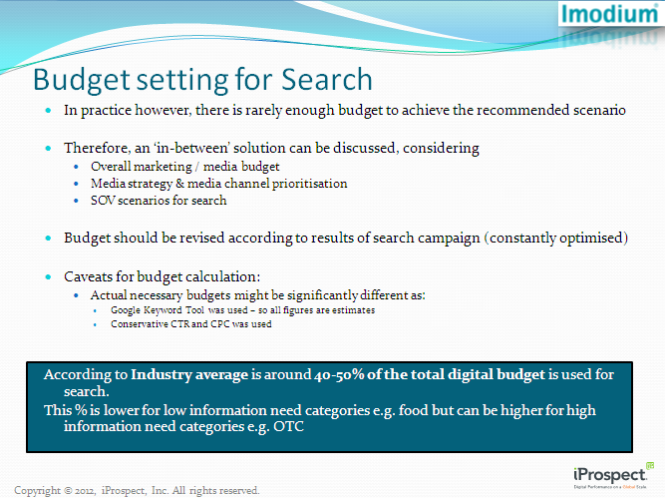
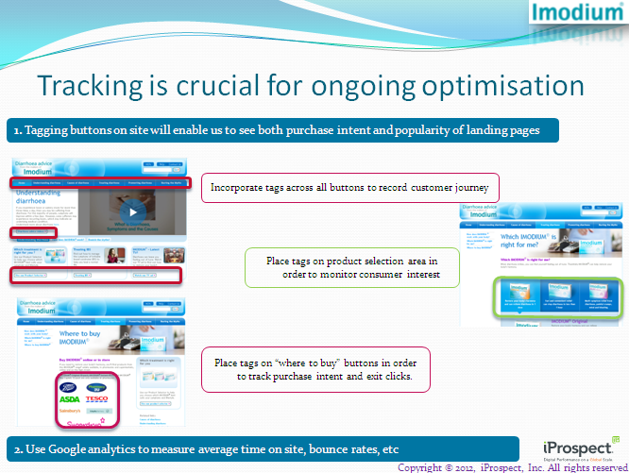
Strategy
Building the Search Toolkit
Strategy
Working with the Carat team, a search toolkit was created for J&J Clean and Clear. The toolkit educated the local brand managers in paid search.
Whilst working on the toolkit with the Carat team, we were also educating the Carat team in paid search.

Slide 5

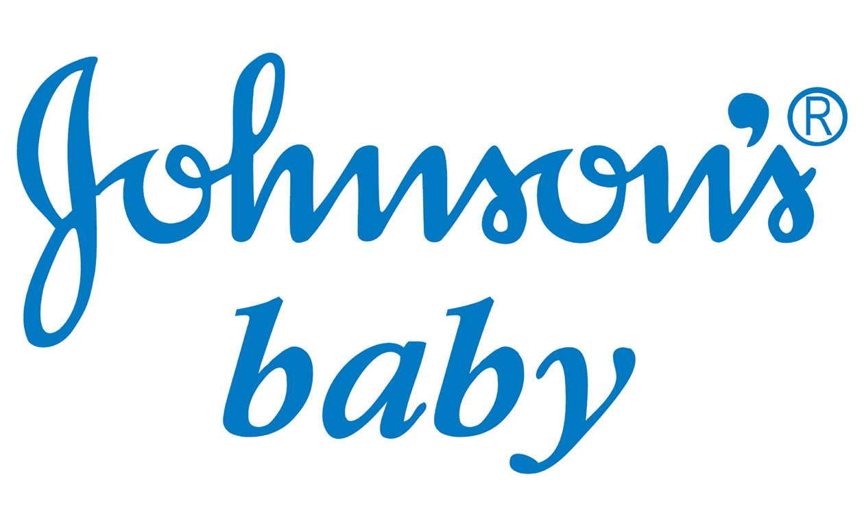




Results
£83k Out of Scope Revenue & More
One initial toolkit turned into 4 toolkits for the iProspect/Carat team which were all out of scope work.
Toolkits generated £83K out of scope revenue for Carat and iProspect.
Carat now have high level search knowledge
Positive word of mouth across the J&J client as we demonstrated how well we work collaboratively cross agency
Imodium Global Franchise Director, Marni Allen
“I have been very impressed by the combined team of J+ and iProspect to help us better understand how critical digital media activities are, and increasing our level of support to the markets in this area.’’

